Slide 1

Accelerate Convolutional Neural Network
Ezekiel Tay z5378748
Kenneth Law z5363506
Sicheng Jin z5317861

Slide 2
Project Overview
Objective: Investigate the performance gains of accelerating convolution layers in CNN inference using FPGA.
Context: CNN convolution layers are compute-intensive to deploy on low-energy/cost embedded systems. Often taking over 90% of runtime on deeper models.
Project Scope: Implement a CNN ("ToyCNN") on the Kria KV260 board, leveraging both CPU (PS) and FPGA (PL) to classify handwritten digits of the MNIST dataset
Result: Achieved a ~82% inference speedup, with the convolution layer accelerated by a factor of ~140x.

Slide 3
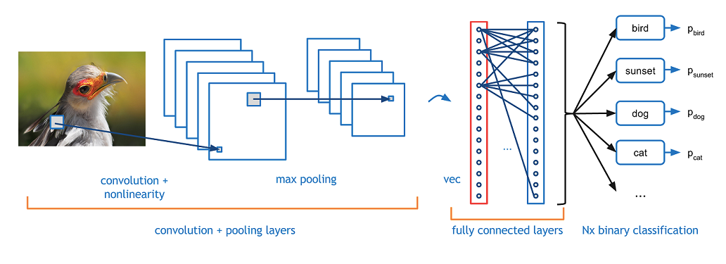
Quick Recap on CNNs
A Convolutional Neural Network is a class of neural networks that specializes in processing data containing spatial features, such as an image.

Slide 4
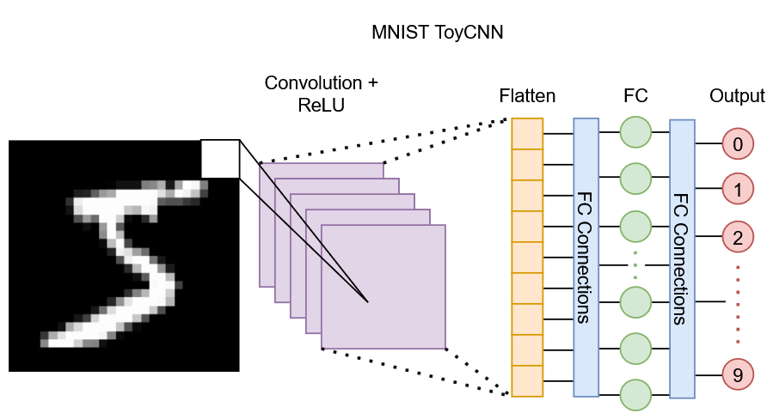
ToyCNN
Convolution layer -> (main target of speed ups)
Activation layer (Relu)
Flattening
Fully connected layer

Slide 5
Aims and Goals
Develop a lightweight CNN inference pipeline for handwritten digit classification (Data from the MNIST dataset)
Examine the baseline SW implementation performance
Leverage the strengths of both Processing System (PS) and Programming logic (PL) to minimise latency via hardware/software co-design
Eg. Offload the expensive convolution operations to FPGA logic
Compare performances on the KV260 board

Slide 6
Results
An accelerated design was achieved!
Baseline (SW-only):
~43.1s to classify 10,000 images
Averaging 4.31ms per image
HW+SW version:
~23.6s to classify 10,000 images
Averaging 2.36ms per image
140× convolution layer speed-up, ~82% total runtime reduction.

Slide 7
AI Usage
Assist in developing the python code for the training process to obtain the weights and biases.
Generating C++ code for the 3-line buffer (Sliding image across kernels instead of kernels across image)
Debugging why unrolling the dot product loop didn’t synthesise an adder tree
Floating-point addition is non-associative due to rounding
HLS does not create adder tree by default
Introduced manually

Slide 8
Design
Solution approach
Model
A custom small CNN trained on MNIST
Layers:
Conv: 8 3x3 kernels
ReLU
Flatten
FC: 10 nodes, 5,408 connections each
PyTorch was used for training
99.88% train accuracy
97.82% test accuracy
Trained weights were exported to C++ headers for inference code.

Slide 9
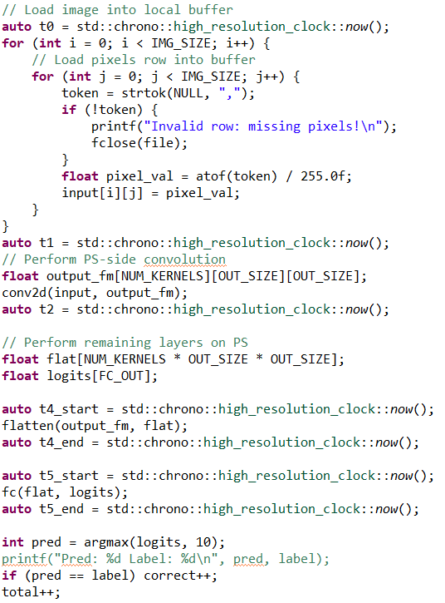
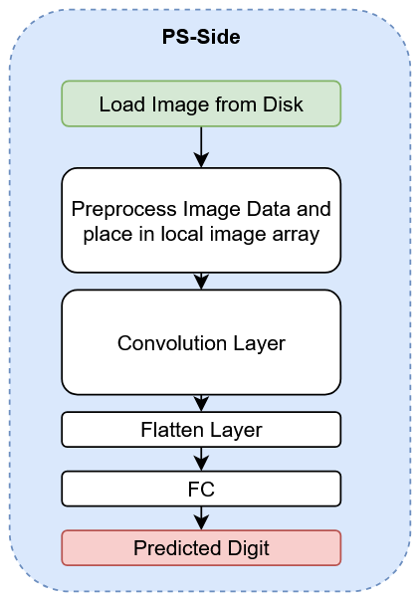
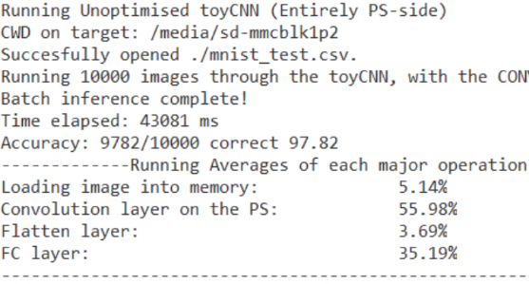
Baseline Design
Baseline Design
SW-only side
ALL operations are done on the CPU

Slide 10
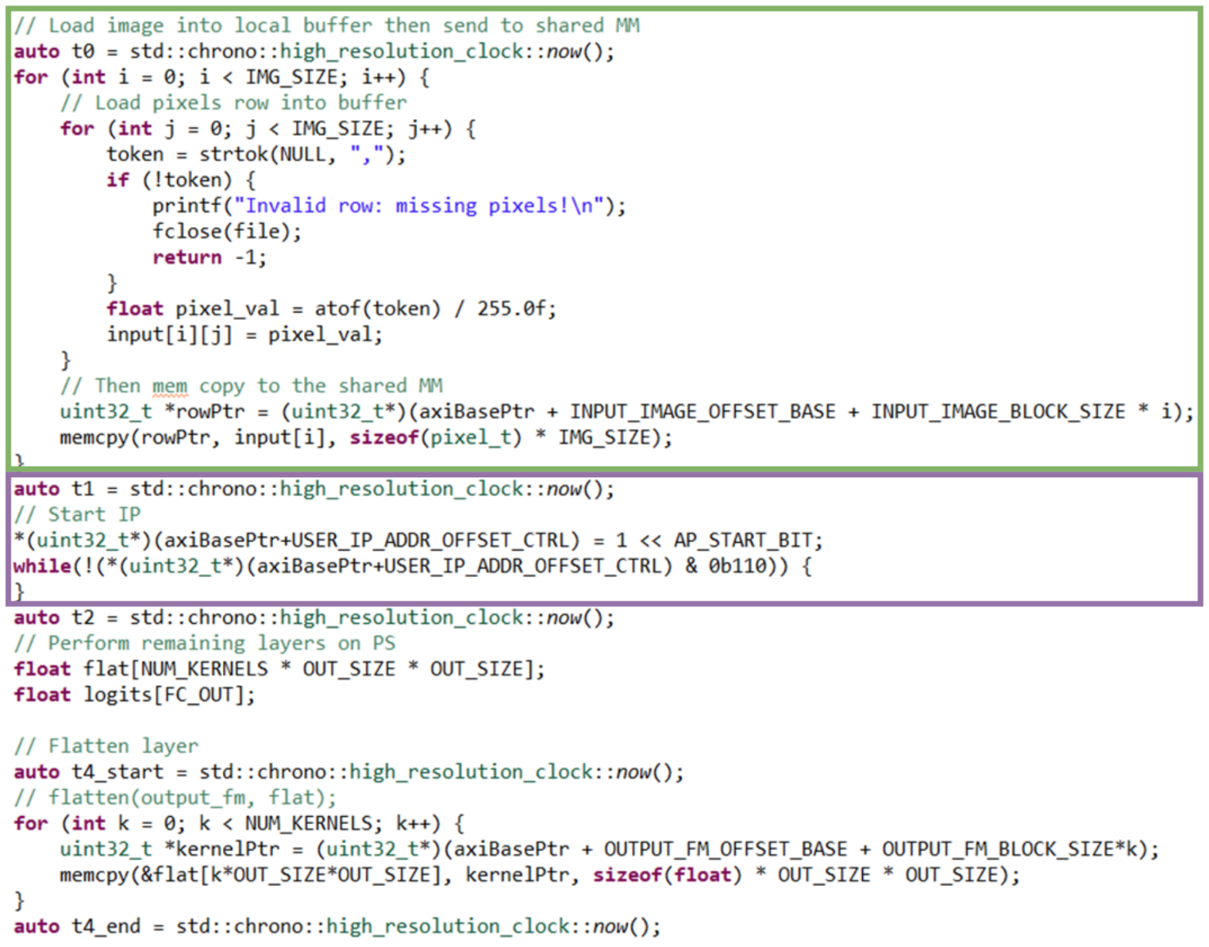
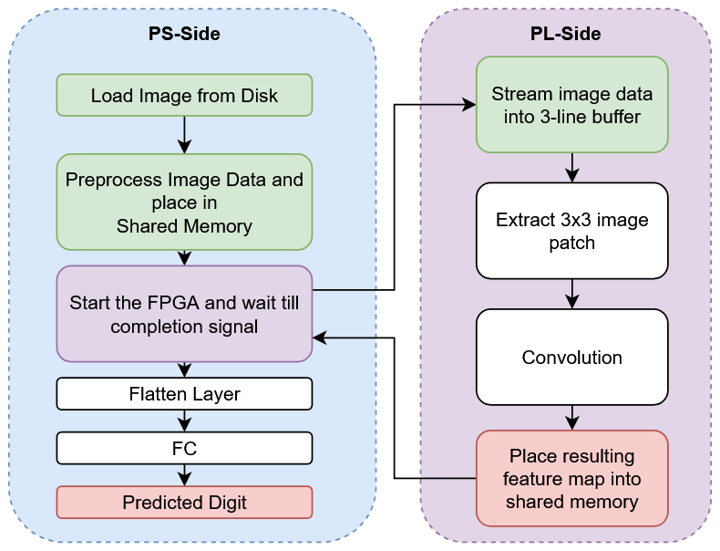
Accelerated Design
Solution approach
SW (CPU) side
Handle the image preprocessing and data movement via memcpy
Pilots the FPGA
Leverage the CPU’s fast sequential processing power to compute the FC layer

Slide 11
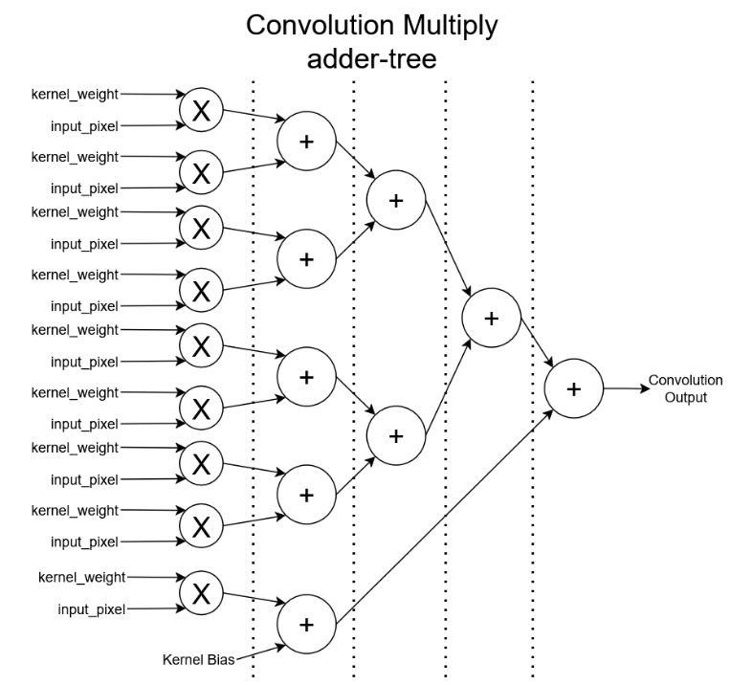
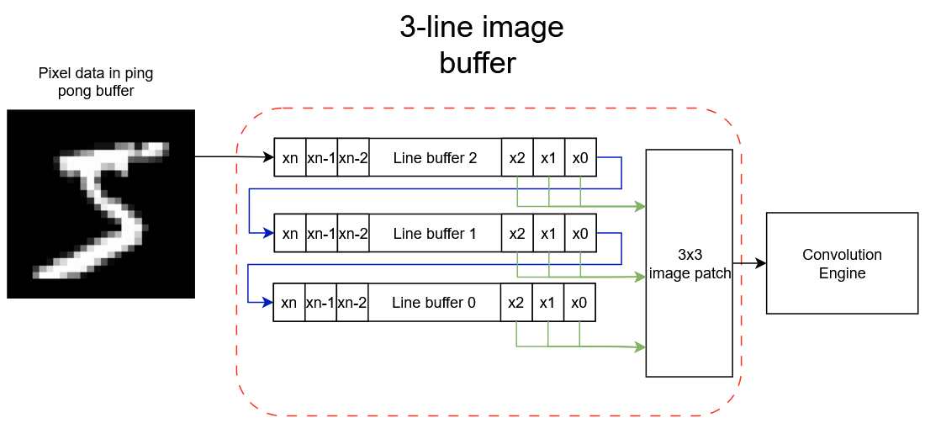
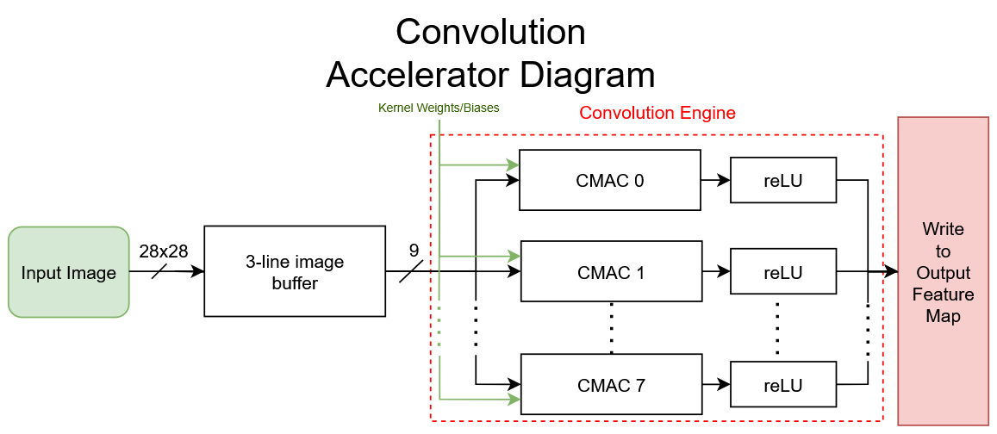
Accelerated Design
Solution approach
HW (FPGA) side
Leverage the FPGA’s parallel processing power to perform convolution
Key components are:
Convolution Multiply Accumulate (CMAC)
3-line image buffer
Parallel data writers to the output feature map

Slide 12
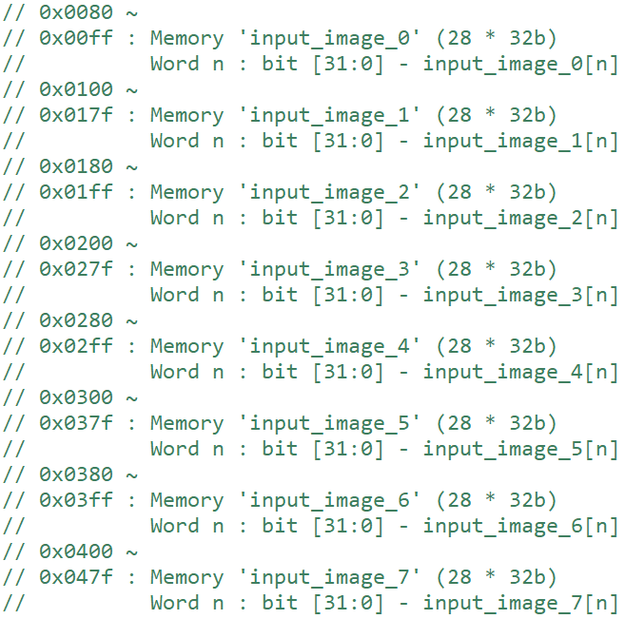
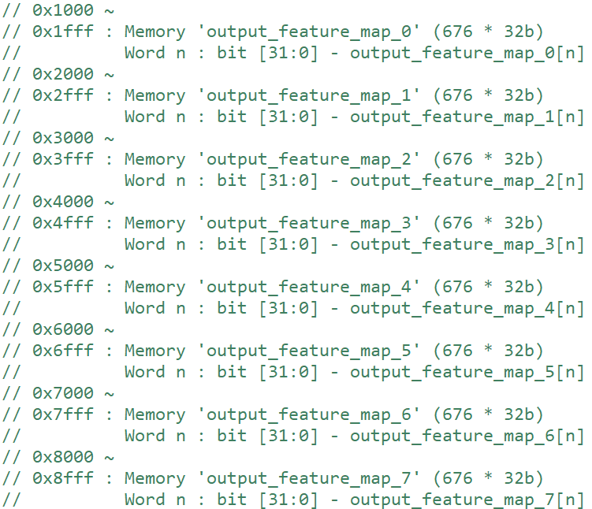
Accelerated Design
Solution approach
HW (FPGA) side
Used the AXI-Lite interface to transfer data to and from the PS and PL sides with a shared memory space (35.6KB shared data)

Slide 13
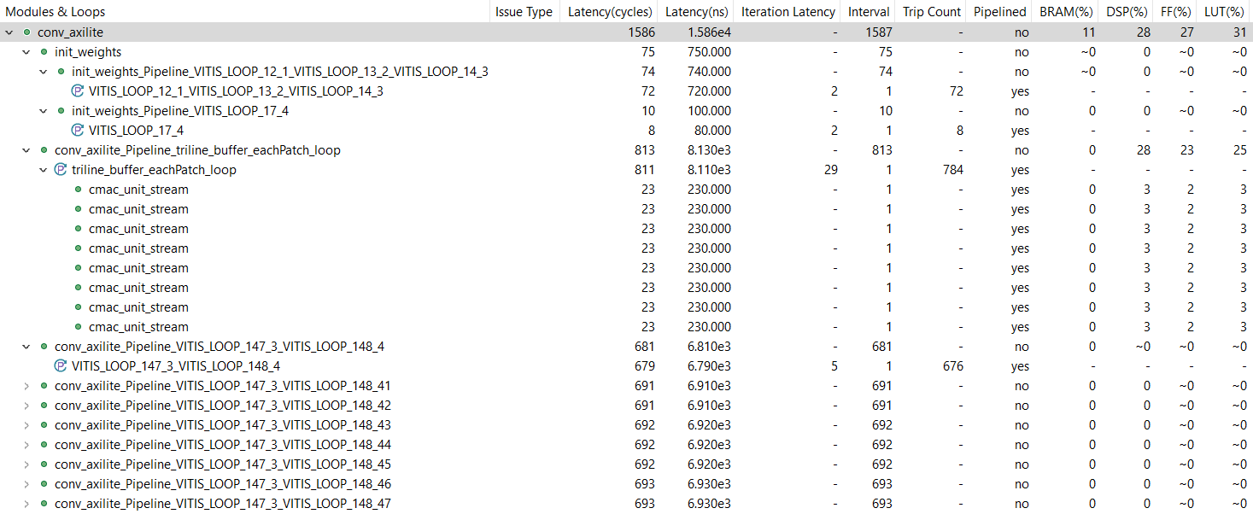
Accelerated Design
HW Resource utilization
1586 cycle latency (est. 15.86us)
Nearly a third of the DSPs, FFs and LUTS and only 11% of the BRAM

Slide 14
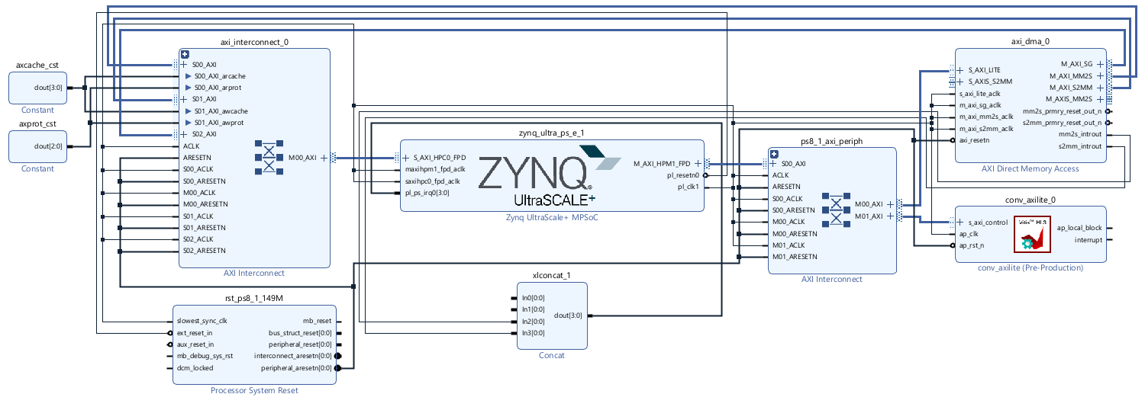
Accelerated Design
Block Design
Used the AXI-Lite interface to transfer data to and from the PS and PL sides with a shared memory space

Slide 15
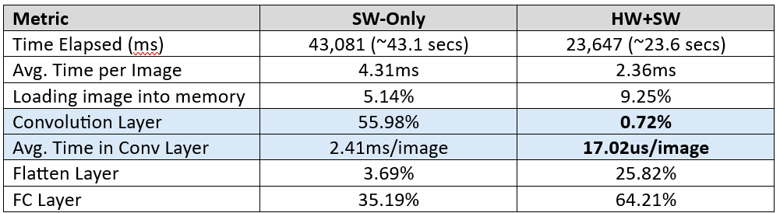
Results
Performance Evaluation
82% overall gains
Convolution layer accelerated by 140x
HW+SW solution closely matched synthesis estimates (15.86us)

Slide 16
Discussion
Speedup:
Significant performance gains to the convolution layer of over 140x
Demonstrating effective usage of FPGA parallel processing power
Limitations:
Amdahl’s law: Convolution is no longer the bottleneck
Data movement and remaining layers, especially FC dominate runtime
Scalability:
Greater benefits expected for deeper CNN architectures

Slide 17
Conclusion - What worked?
Efficient Hardware Acceleration:
CMAC
8 fully pipelined CMAC units with II=1 working in parallel provided high throughput and fast convolution operations
3-Line Image Buffer
3-line image buffer eliminated the need to slide the kernels in each CMAC, instead sliding the image under the kernels
Reduced redundant duplicate computations and allowed CMAC units to remain simple and efficient
Parallel Output Writers
Each feature map for each kernel was written in parallel by 8 output writer modules
Avoiding bottlenecks in writing large amounts of data back to memory.
Shared Memory Optimisation via AXI-Lite
Although basic, throughput was maximized by
Partitioning arrays for full parallel access
Aligning memory into 128B and 4KB blocks for efficient memcpy’s for PS and PL data transfer
Inference accuracy preserved
Used float operations to maintain model accuracy.

Slide 18
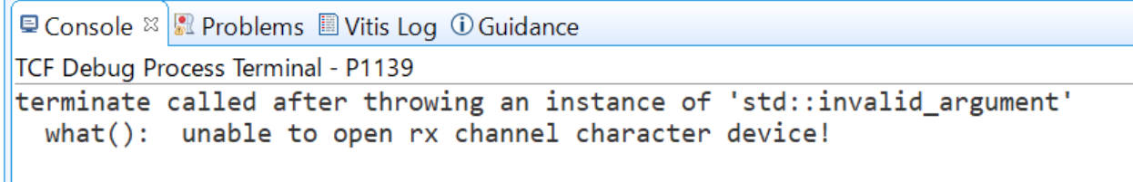
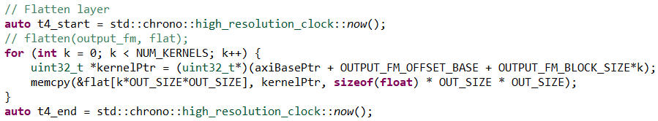
Conclusion - What didn’t work?
AXI-Stream
Originally planned, but technical difficulties arose… Meaning we abandoned the ping pong buffer
Flatten & FC Layer in SW
Since the conv layer freed up CPU time, the flatten and FC layers filled in, taking up 25.82% and 64.21%, respectively.
This is NOT due to FPGA data writing overhead, but memory intensive operations

Slide 19
Conclusion - What didn’t work?
Fixed-Point Arithmetic
Although changing from floating point to fixed point could further reduce FPGA resources and latency, decided to skip this endeavour
Early results indicated bottlenecks were elsewhere
Even if we pursued this, Amdahl’s law would make the overall gains negligible (FPGA already only takes up 0.72% of runtime)
Not worth negligible gains at the cost of accuracy loss
FFT-based Convolution
Only feasible for large networks
Software & Toolchain Difficulties
Significant pain and suffering using the Xilinx tools (especially Vivado HLS 2020.1), particularly due to version mismatches.
Lots of time wasted, slowing development
Our solution: Use Vitis HLS 2021.2!
XSCT only worked on Stefan’s computer for some reason

Slide 20
Conclusion – If given more time
Model quantisation during training
Fixed point weights generated during TRAINING
Runtime reconfigurability
Opens ability to run models with multiple convolutional layers
AXI stream implementation
Dataflow design with ping pong buffers
Potentially decreasing the flatten layer runtime as the output gets streamed into it

Slide 21
Conclusion – If given more time
Software Algorithms
Winograd
Divide the whole input image into 4*4 chunks
Pre-calculate and store the optimal matrices for 4*4 input
Saves 50% of calculations
Wallace Tree
Concept discovered during our preparation for the seminar
Speed up the multiplication of binary numbers by efficiently summing partial products.
Reduce the carry propagate delay
Reduce the number of adders
Potentially decrease the LUT usage as seen in research papers

Slide 22
Thank You

